Slide 1


Digital Humanities
Dariah and other digital humanities projects
Warsaw University, 27 November 2014
Włodzisław Duch
Under-Secretary of State
Ministry of Science and Higher Education
address: ul. Hoża 20 \ ul. Wspólna 1/3 \ 00-529 Warszawa \ phone: +48 (22) 529 27 18 \ fax: +48 (22) 628 09 22
www.nauka.gov.pl

Slide 2

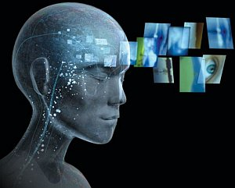
I want to Digitize
Many initiatives towards digitization of almost everything in the world … net is the place to be (forget libraries …).
Funds from national budget or EU operational programs: Innovative Economy (POIG), Human Capital, Regional Programs, flowing through different channels.
In 2014-2020 new operational program „Digital Poland” (POPC, PO Polska Cyfrowa).
Worth about 8 mld PLN (2 bln €), including digitization of public data, creation of repositories of cultural objects.
www.nauka.gov.pl

Slide 3
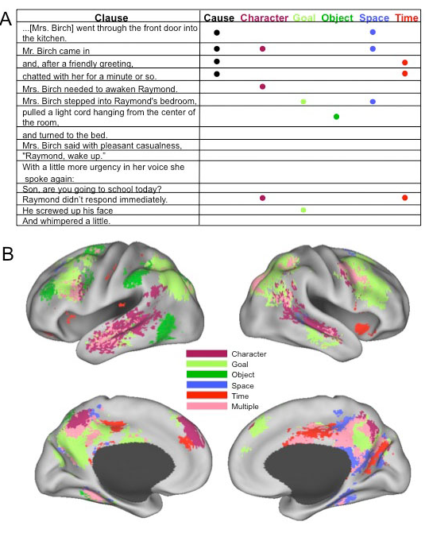
Thoughts
Nicole Speer et al. Reading Stories Activates Neural Repre-sentations of Visual and Motor Experiences. Psychological Science 2009; 20(8): 989–999.
Thought: spatiotemporal pattern
Meaning: always slightly different, depending on the context, but still may be clusterized into relatively samll number of distinct meanings.
www.nauka.gov.pl

Slide 4
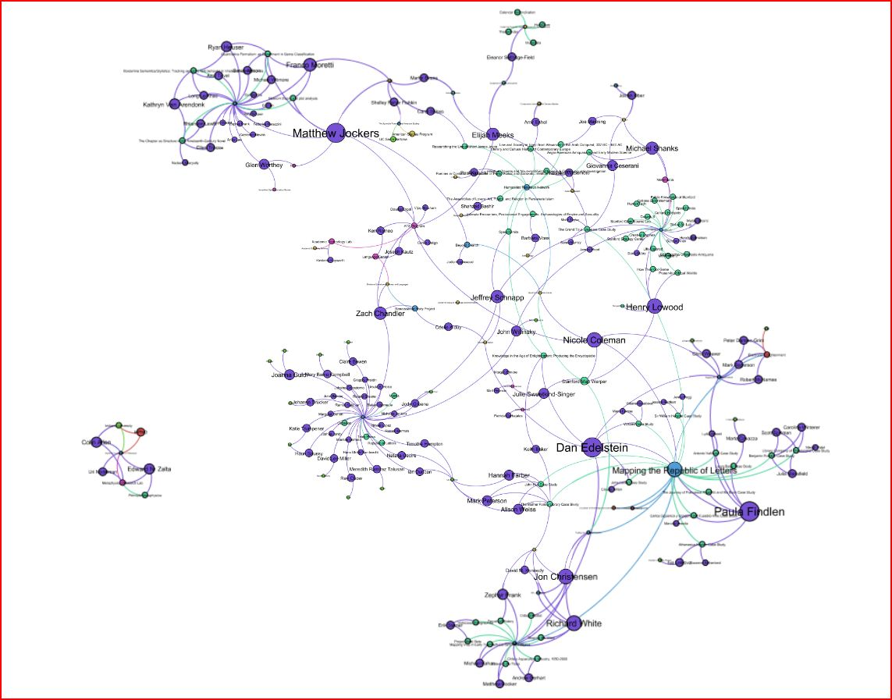
DARIAH – mindmap of all experts
www.nauka.gov.pl

Slide 5
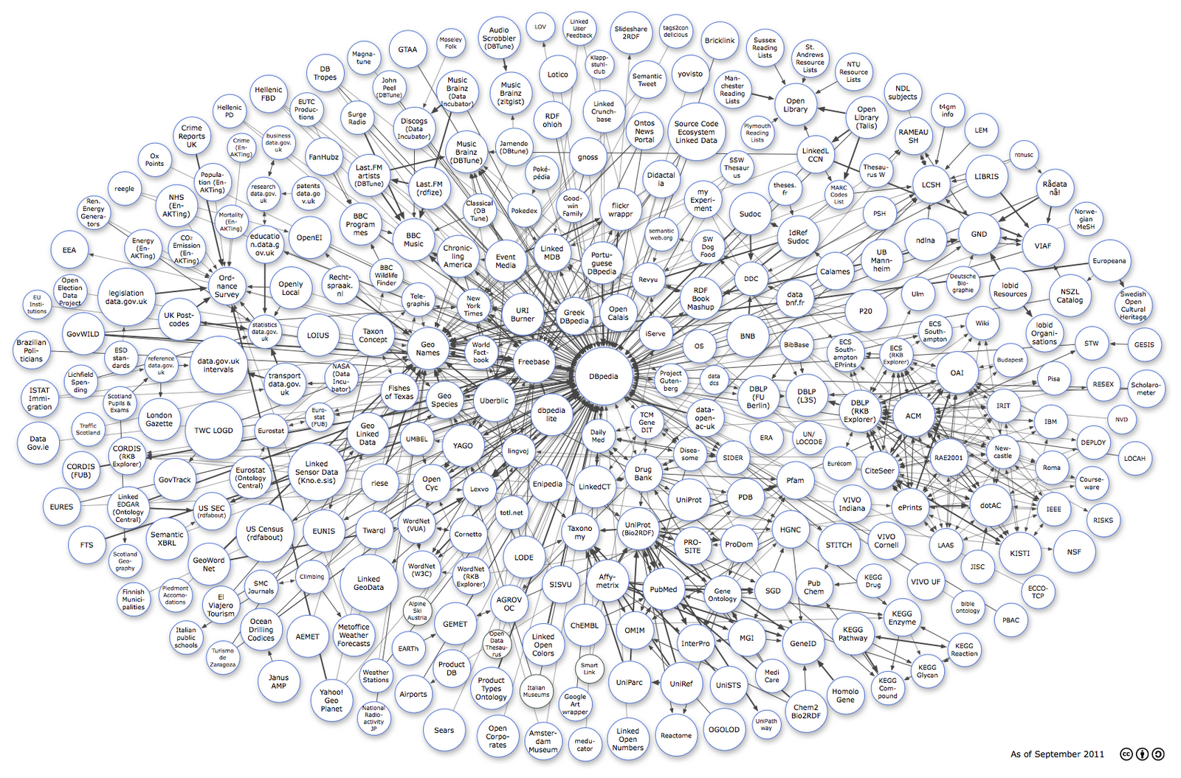
DARIAH – mindmap of all experts
www.nauka.gov.pl

Slide 6
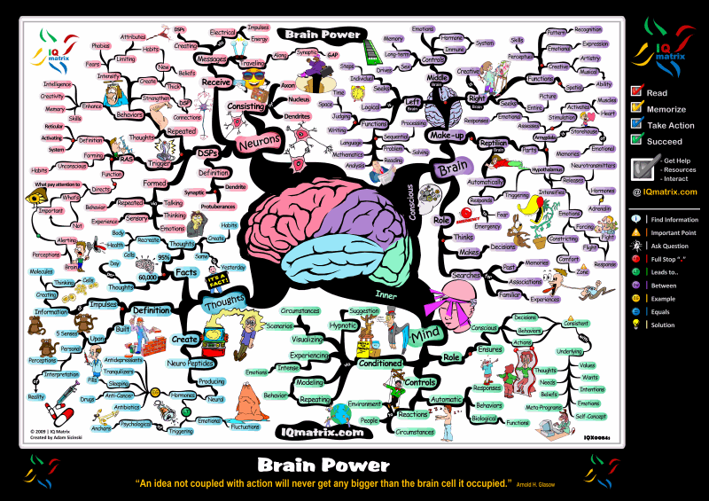
DARIAH – mindmap of all experts
www.nauka.gov.pl

Slide 7
Repositories in Poland
In the middle of 2014 we had 24 active scientific repositories:
22 – institutional repositories
1 – specializing in history, art, music … (Lectorium.pl)
1 – Center for Open Science repository.
What kind of institutions create them?
Universities, national and private (over 700 supported)
Polish Academy of Science (70 units)
Consortia of research institutes (116 institutes)
Scientific Societies
www.nauka.gov.pl

Slide 8


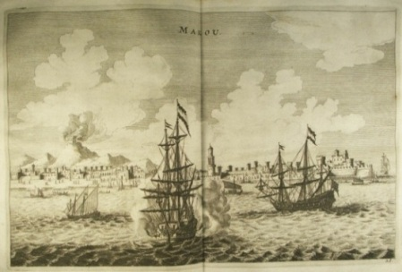
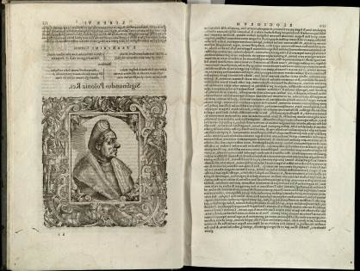
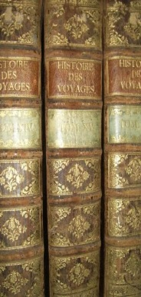
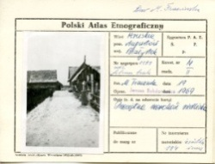
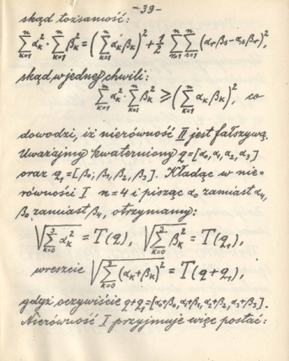
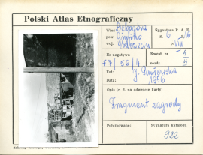
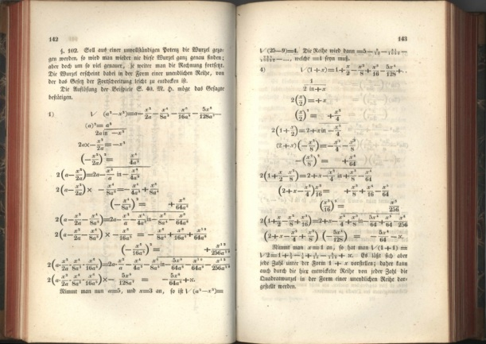
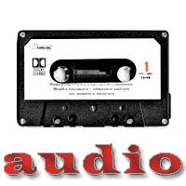
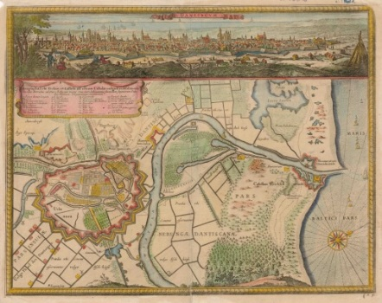



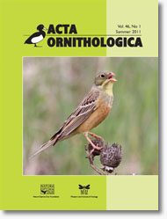
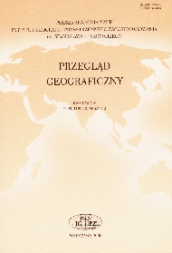
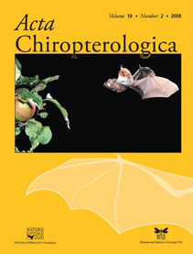
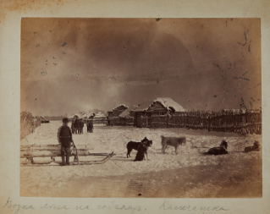
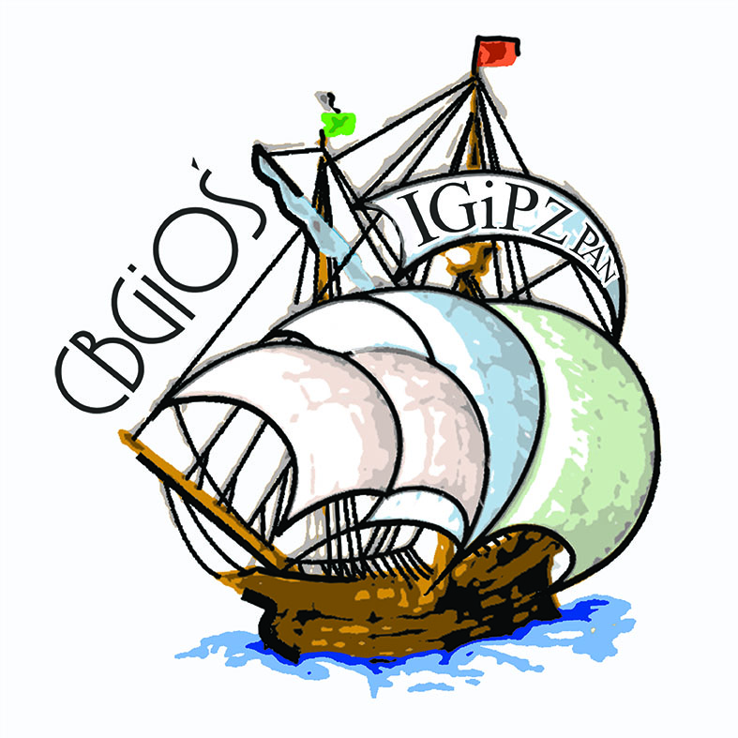
RCIN (http://rcin.org.pl) includes professionally prepared current scientific publications of the Academy of Science and Research Institutes (over 40 now) including:
journals,
XIX & XX century reprints
incunable
maps,
old prints,
manuscripts,
photographs,
multimedia (audio)

Slide 9
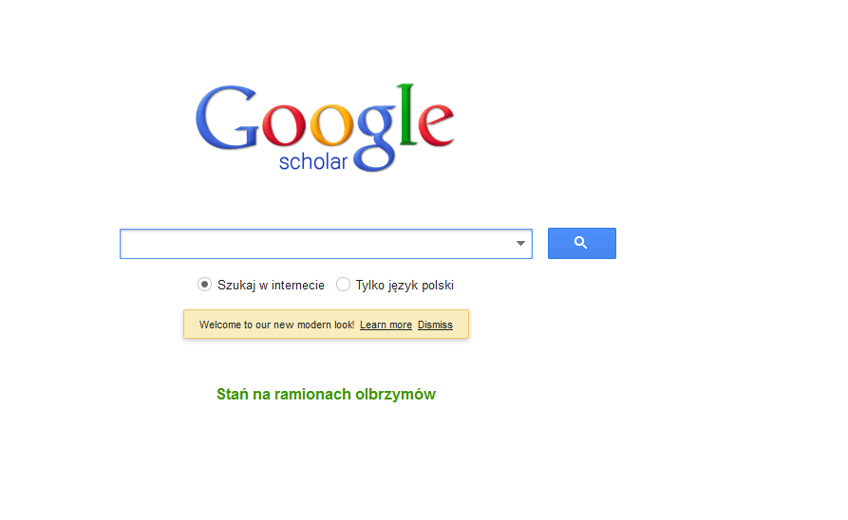
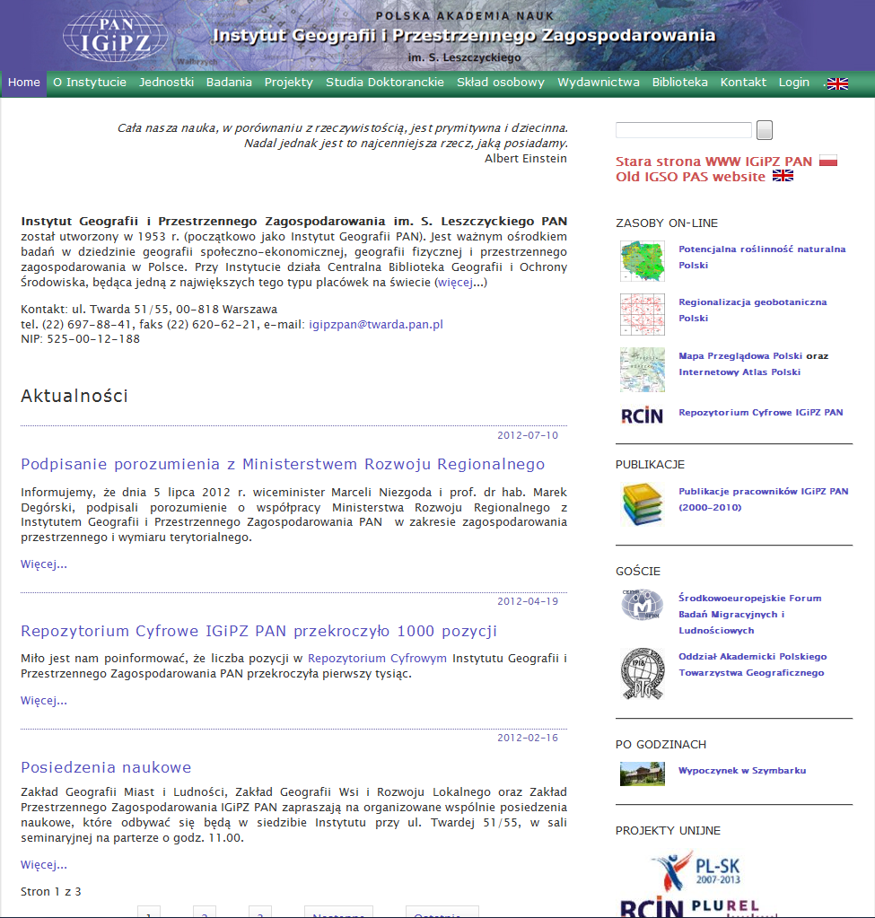
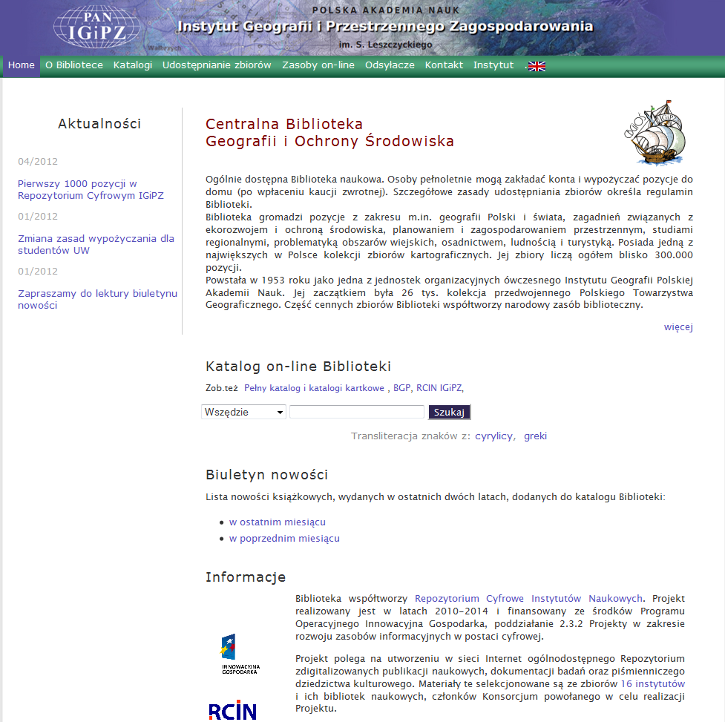
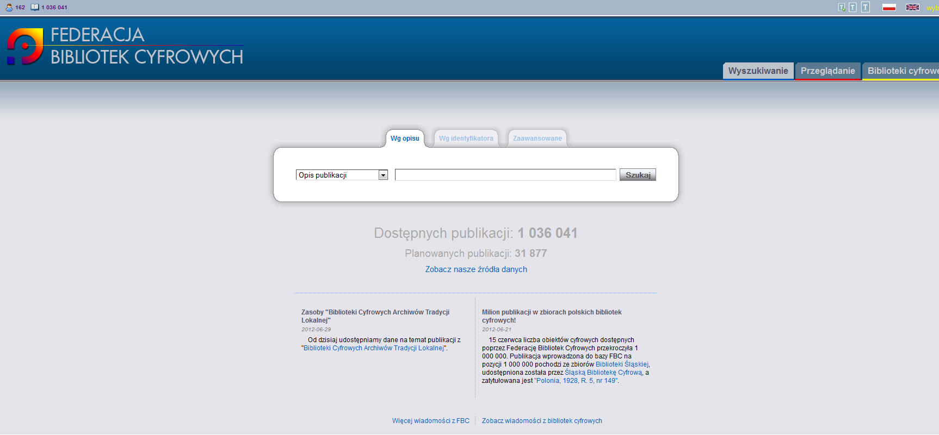
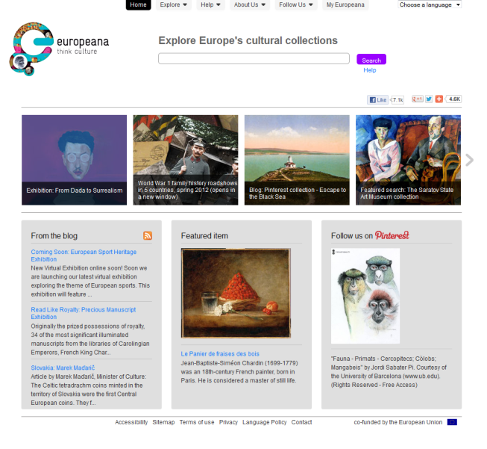
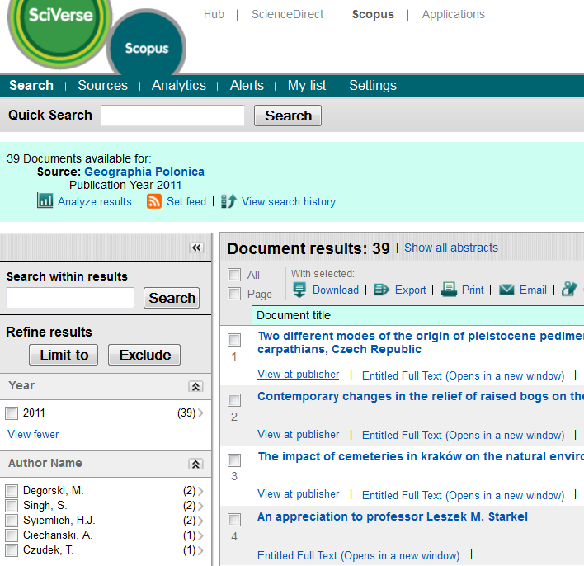
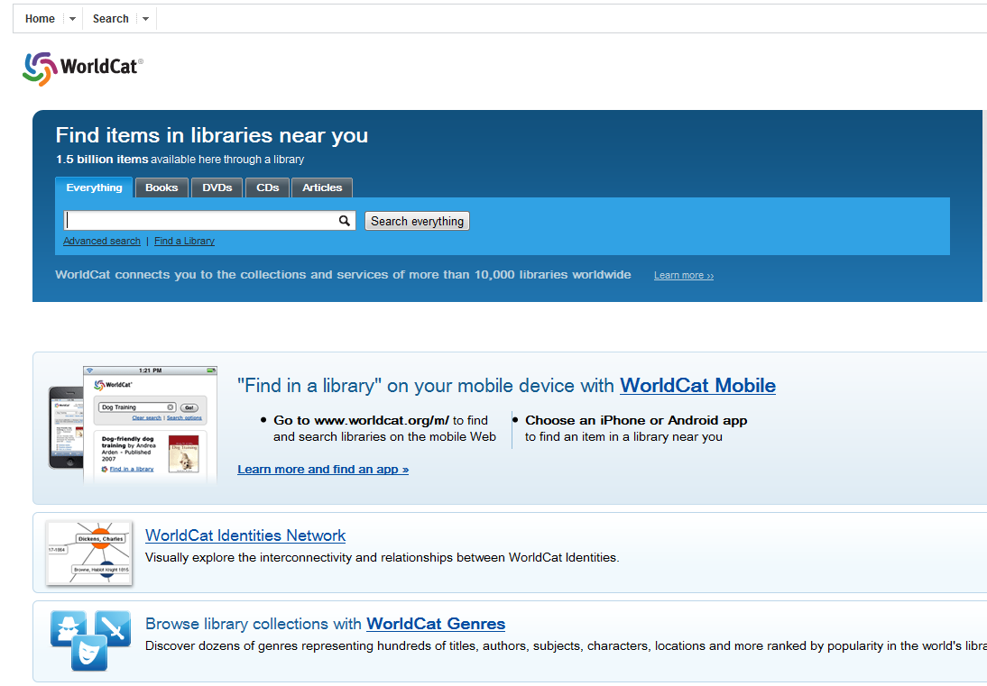
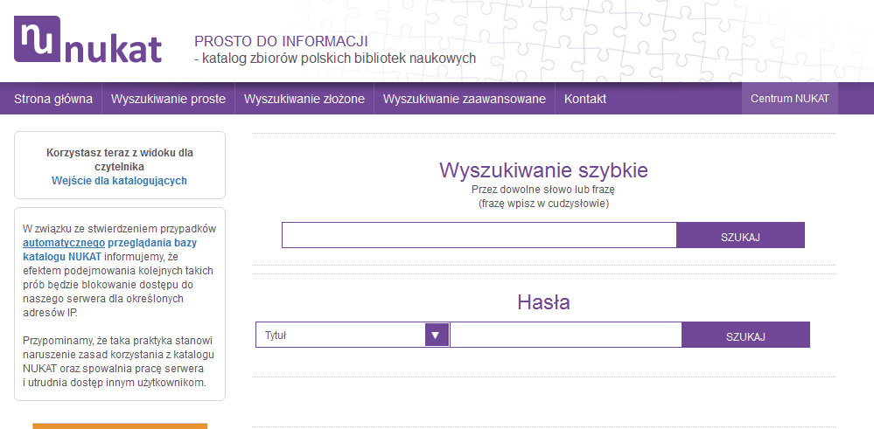
RCIN links to many libraries

Slide 10
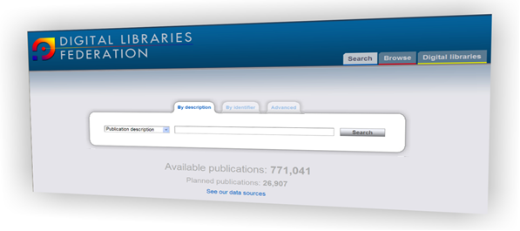
Federation of Digital Libraries
digitalization and access to the Polish cultural heritage,
Over 2 mln of objects (mid 2014), over 560.000 unique users,
105 data sources and 350 institutions contribting,
one of the top providers of digital content to the “EUROPEANA” – European library of cultural heritage
www.nauka.gov.pl

Slide 11
Usage of the Federation of Digital Libraries
Dane wg Google Analytics

Slide 12
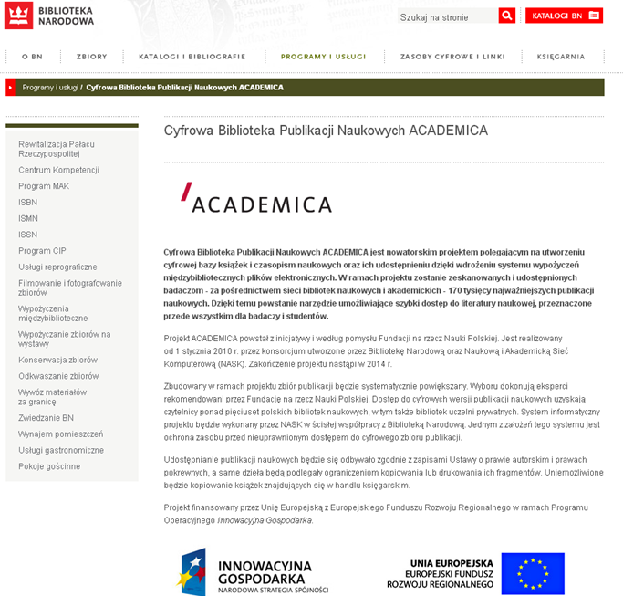
Digital Library of Scientific Publications
ACADEMICA
The Digital Library of Scientific Publications ACADEMICA is an innovative project which consists in creating a digital database of books and scientific journals, copyright protected, available through a interlibrary loan system.
Downside: only in the library. Good as temporary solution.
Solution: Open Science
www.nauka.gov.pl

Slide 13
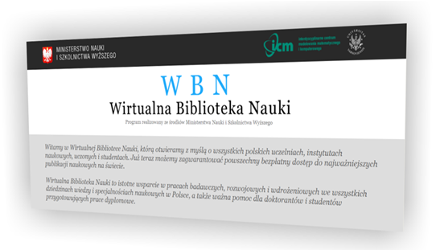
Virtual Library of Science
access for Polish researchers to the scientific repositories of the most important publishers in the world: Elsevier, Springer, Web of Knowledge, EBSCO, Nature, Science (financed fully by the Polish government),
access to other repositories,
co-financed by the Polish government,
possibility of free-of-charge publication in open-access mode for Polish scientists in journals of selected publishers (like Springer), financed by the Ministry.
www.nauka.gov.pl

Slide 14
Electronic academic textbooks
In 2014 we have opened a possibility to create national licenses for free electronic books.
As a part of the Virtual Library of Science we shall help university consortia to fund academic textbooks (in electronic form) used in the educational process.
Not many full courses yet are available through WWW
Regretfully, no MOOCs … this model in EU needs strong financial support from government.
www.nauka.gov.pl

Slide 15
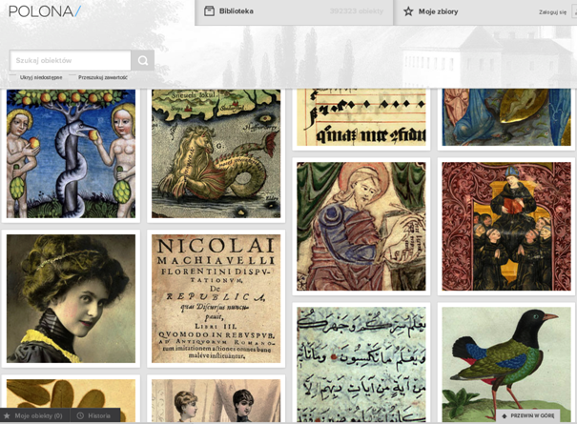
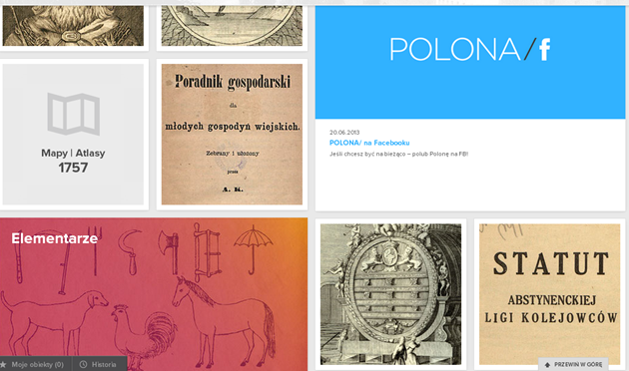
Polona portal
Polona is a modern portal that makes the National Library’s collections available for the general public on the internet. It also presents collections from other cultural institutions.
www.nauka.gov.pl

Slide 16
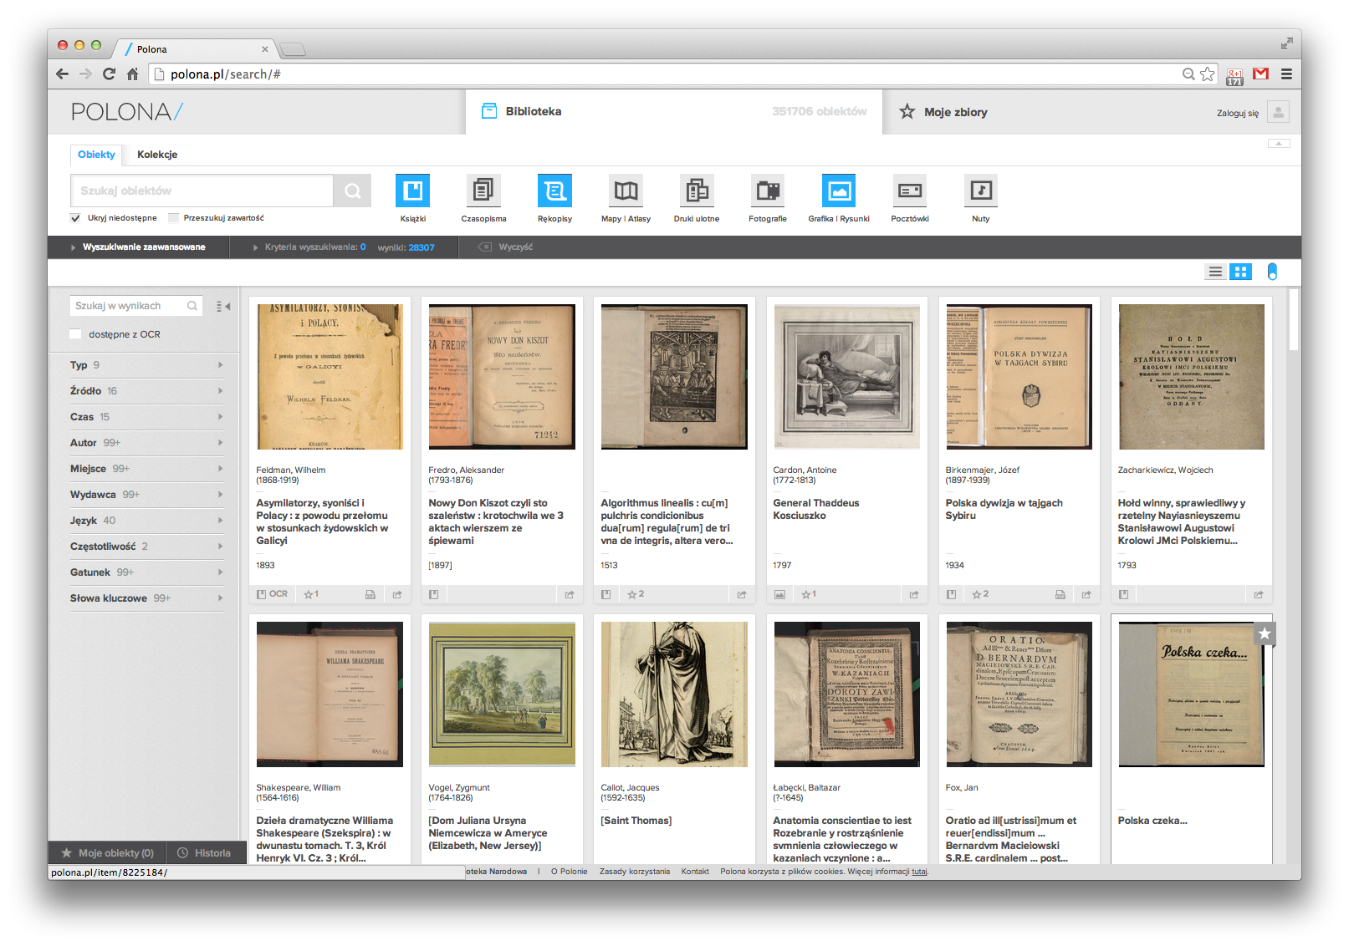

Slide 17
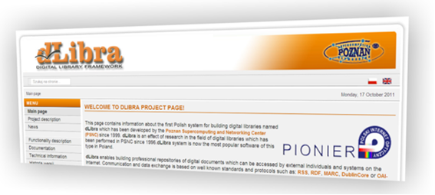
dLibra
the first Polish system for building digital libraries,
dLibra is used by institutions such as academic and public libraries to make stored digital publications available on the Internet
www.nauka.gov.pl

Slide 18
Central Repository of Thesis
The Ministry of Science and Higher Education creates a Central Repository of Thesis.
Each university will be required to verify the originality of its students’ thesis before the final exam using an in-house anti-plagiarism program interfacing with the Central Repository of Thesis.
The inclusion of university thesis databases to expand the Central Repository of Theses will facilitate plagiarism detection both by the promoter and by the Polish Accreditation Committee.
The entity responsible for administering the Central Repository of Theses will be the minister responsible for higher education, while the choice of anti-plagiarism software will be up to each university.
The regulations will be effective from the academic year 2015/2016.
www.nauka.gov.pl

Slide 19
Polish Scholarly Bibliography (PBN)
The Polish Scholarly Bibliography (PBN) is a portal of the MS&HE, collecting information on publications of Polish scientists in Polish and foreign scholarly journals.
It is a part of POL-on, the System of Information on Higher Education.
With the Polish Scholarly Bibliography one can:
create a public bibliography of a person or an institution,
get to know the achievements of Polish scholars and institutions,
submit a journal questionnaire during an evaluation period,
enable users to deposit full texts of publications in a central repository.
PBN will also:
allow users to maintain personal and institutional bibliographies.
integrate with institutional repositories in Poland.
www.nauka.gov.pl

Slide 20
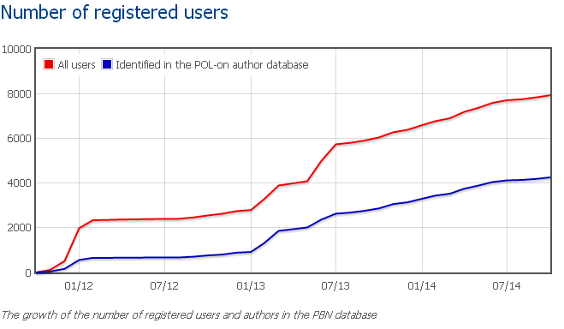
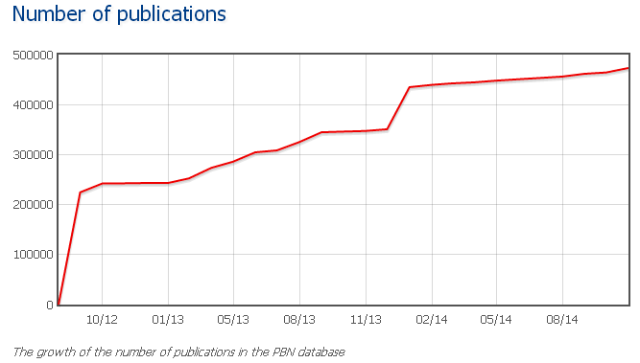
Polish Scientific Bibliography (PBN)
In 2015 should collect data from all repositories and become main tool for impact evaluation.
www.nauka.gov.pl

Slide 21
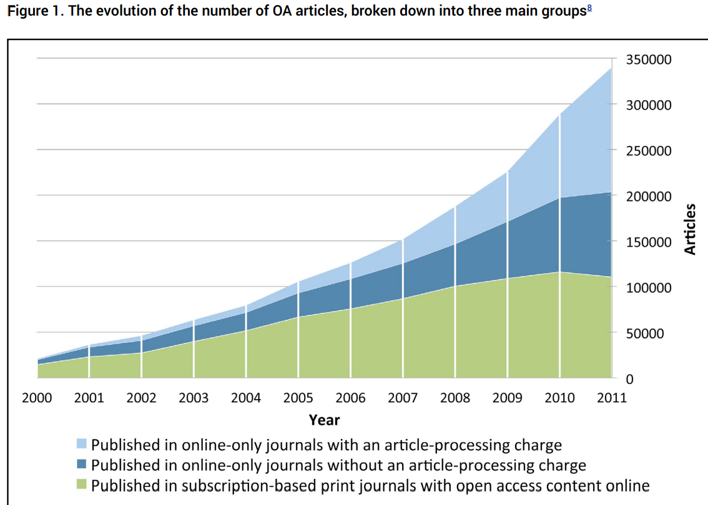
www.nauka.gov.pl

Slide 22
Encouraging Open Science by:
access to scientific literature (journals and books) through national licenses for Springer, Elsevier, Wiley, Nature Publishing and other publishers;
negotiating national licenses for Open Access publications in major journals, free for scientists, paid by the Ministry;
creating our own repositories and digital libraries;
creating our own platforms for open access polish journals, supporting only open access journals; revenue of major English language STM publishers ~9.4 B$
participating in EU projects such as CLARIN, SSH, DARIAH
www.nauka.gov.pl

Slide 23
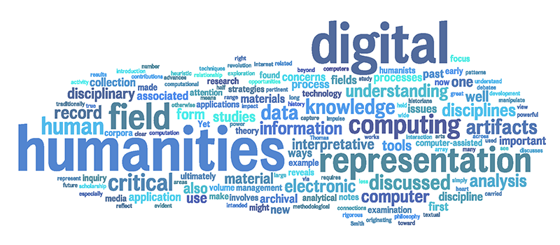
www.nauka.gov.pl

Slide 24
Thank you for your attention.
Prof. Włodzisław Duch
Under-Secretary of State
tel.: +(48 22) 629 36 17
e-mail: sekretariat.mwd@nauka.gov.pl
address: ul. Hoża 20 \ ul. Wspólna 1/3 \ 00-529 Warszawa \ phone: +48 (22) 529 27 18 \ fax: +48 (22) 628 09 22
www.nauka.gov.pl

